Slide 1

Bank Transaction Fraud Analysis
Onyinyechi Sonia Bäckström
Power BI Case Study
August 2026

Slide 2
Project Objective and Dataset Overview
The aim of this project was to analyse bank transaction data using Power BI to identify fraud patterns, understand customer behaviour, create dashboard, present key findings and provide actionable recommendations for reducing fraud risk.
The raw dataset consisted of 2,512 rows and 17 columns, including Transaction ID, Account ID, Transaction Date, Transaction Amount, Transaction Type, Location, Device ID, IP Address, Merchant ID, Channel, Customer Age, Customer Occupation, Transaction Duration, Login Attempts, Account Balance, Previous Transaction Date and Is_Fraud. These variables were used for the analysis.

Slide 3
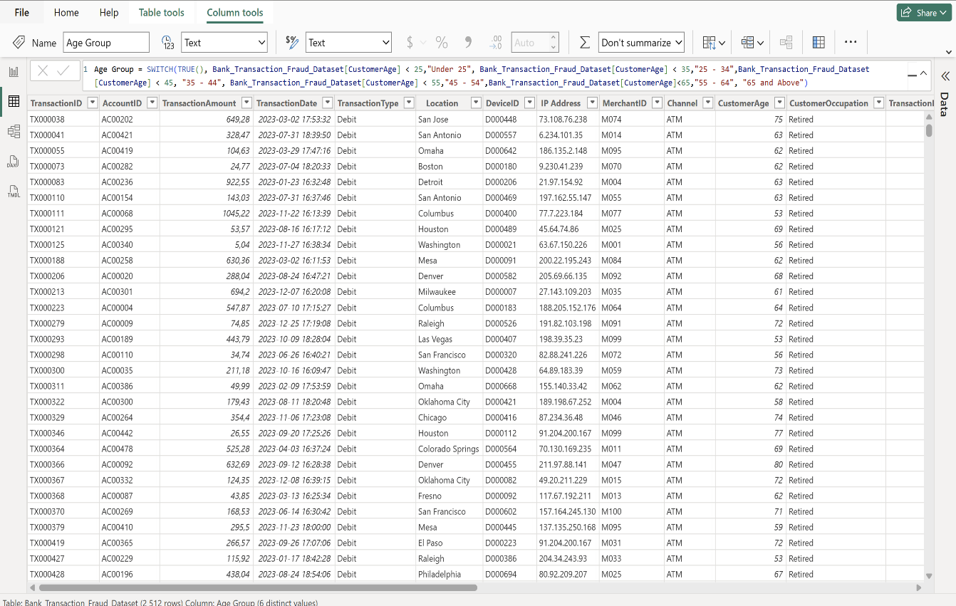
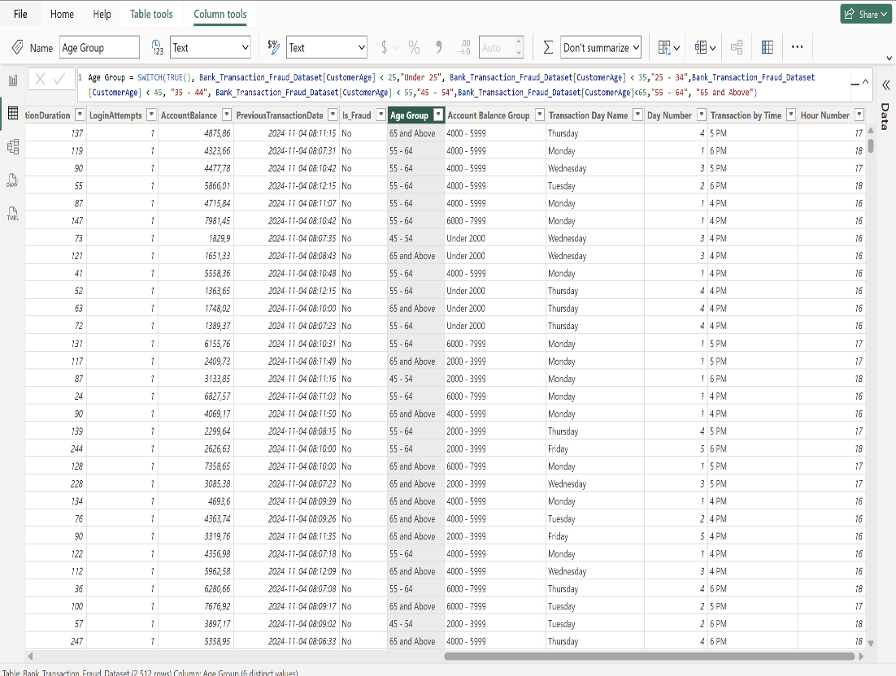
Data Preparation
During data preparation, the dataset was cleaned by checking for missing values, removing duplicate records and correcting data types using Power Query to ensure accuracy and consistency.
Six calculated columns were created (Age Group, Account Balance Group, Transaction Day Name, Day Number, Transaction by Time and Hour Number) together with some calculations using DAX measures to support deeper analysis and dashboard visualizations.

Slide 4
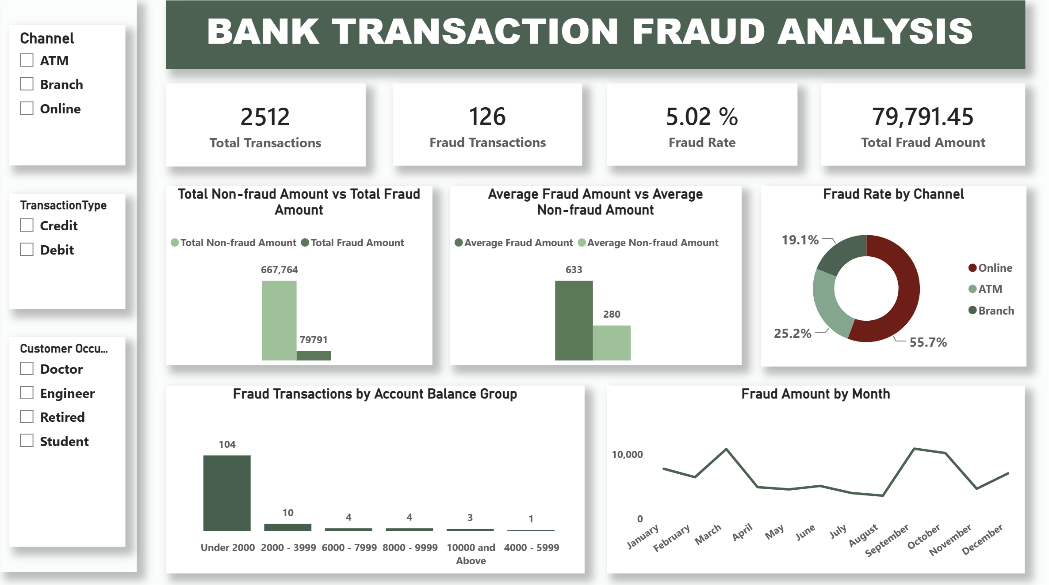

Slide 5
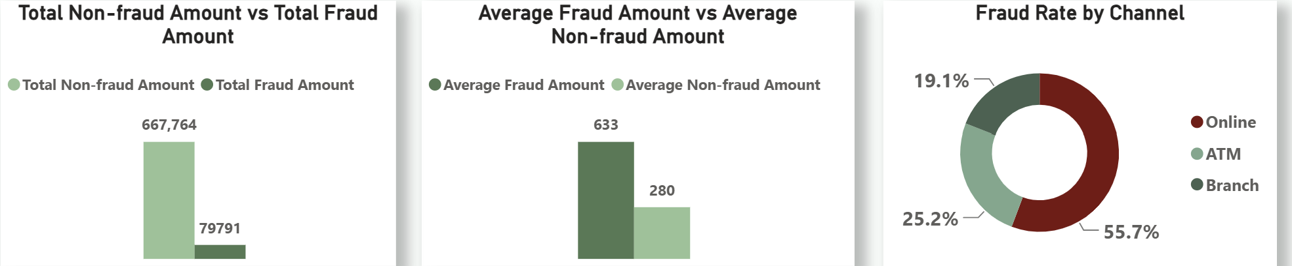
2,512 Transactions were analyzed,126 transactions(5.02%) were fraudulent and Total Fraud Amount is 79,791.45.
Total non-fraud amount is 667,764, which is higher than the Total fraud amount.
Average Fraud Amount is 633 and Average Non-fraud Amount is 280. Fraudulent transactions are significantly higher than the Legit transactions.
Online transaction channel recorded the highest fraud rate by 55.7%, followed by ATM (25.2%) and Branch (19.1%).

Slide 6
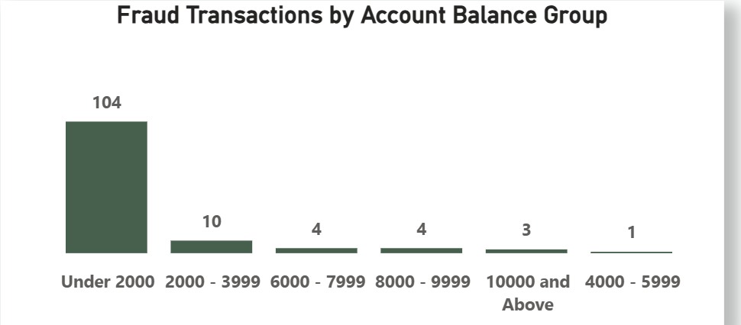
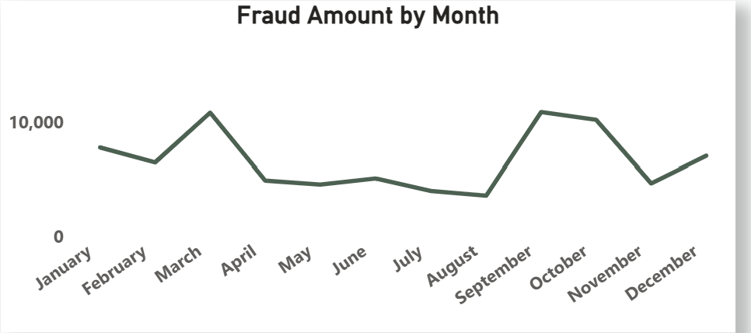
The highest number of Fraudulent transactions occur within the "Under 2000" account balance group, totalling 104 transactions.
The analysis shows seasonal fluctuations in the total fraud amount, with significant spikes in March and October.

Slide 7
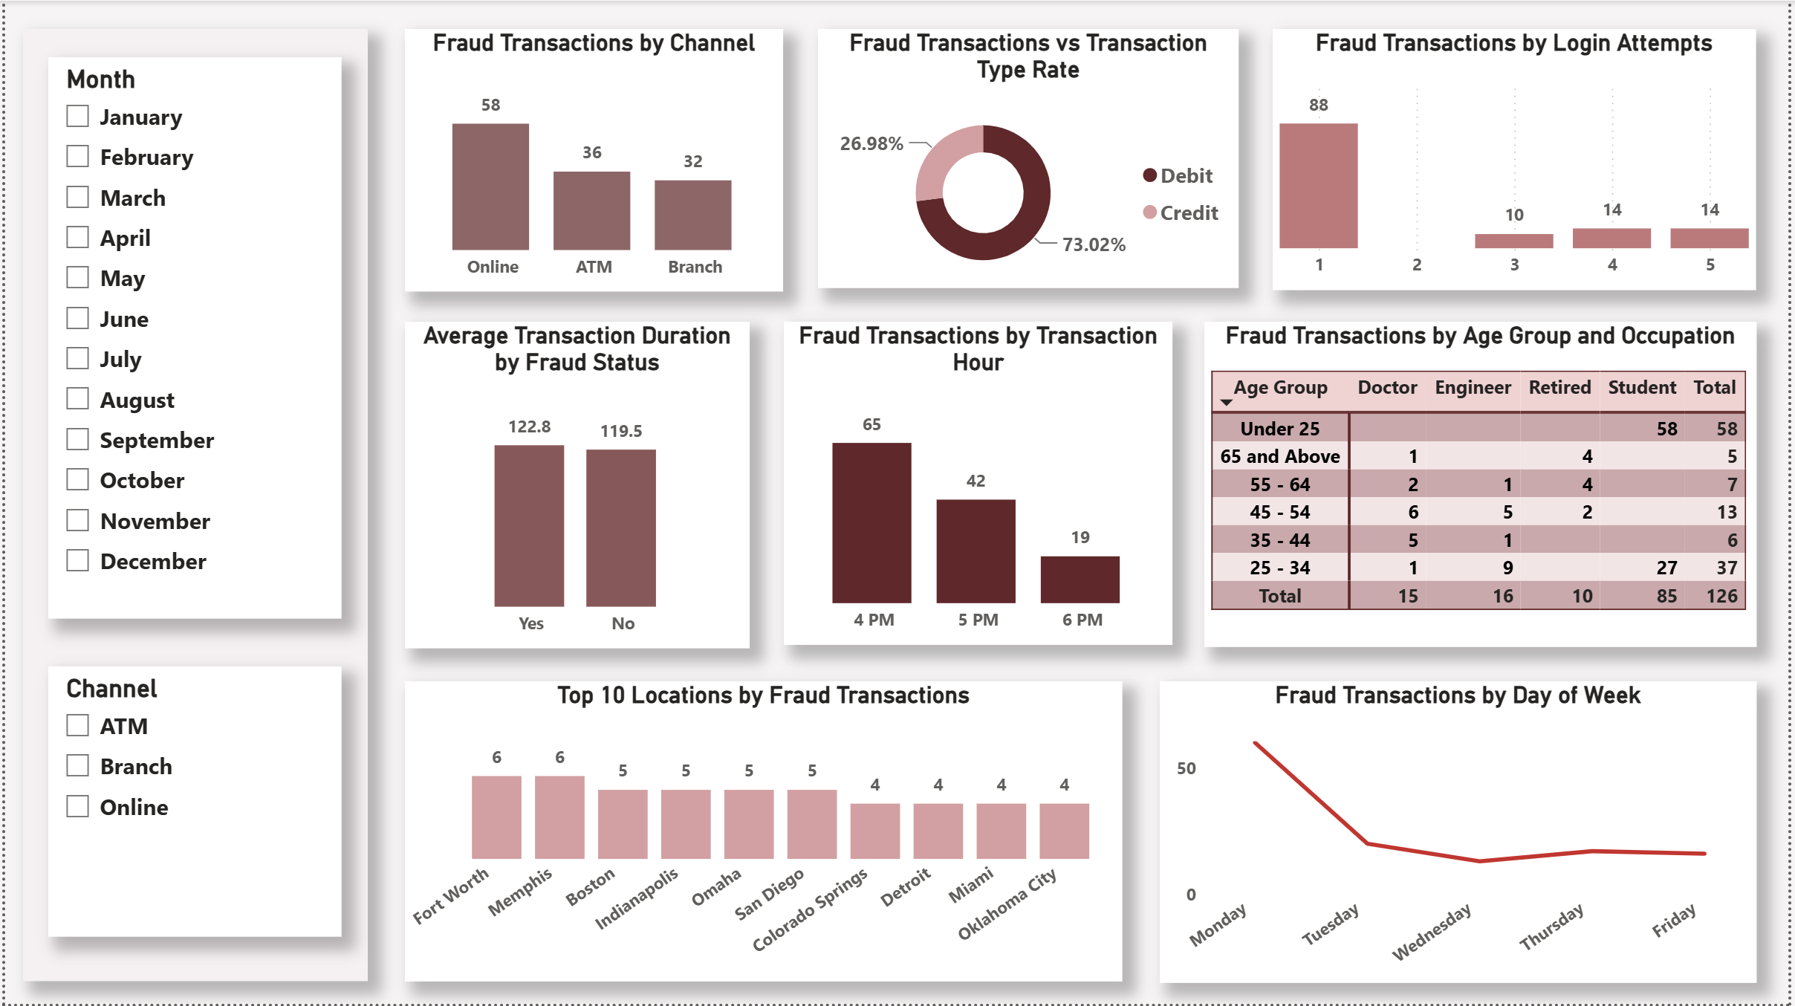

Slide 8
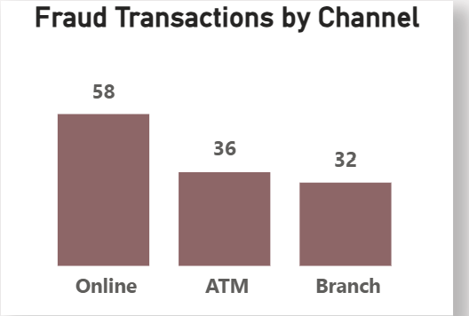
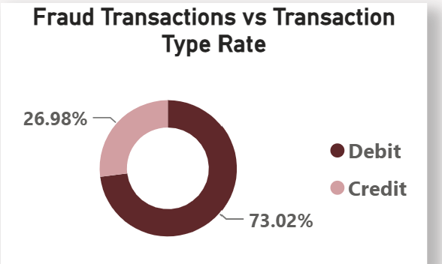
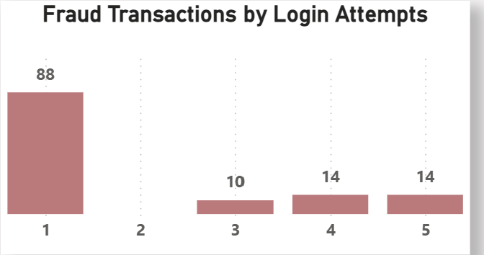
The data indicates online channels are the primary source of fraud transactions, accounting for 58 instances compared to 36 via ATM and 32 in-branch.
Debit transaction type accounted for the most fraudulent transactions, representing 73.11% of the total, while credit transactions account for 26.89%.
Fraudulent activity is heavily concentrated on the first login attempt, with 88 cases, significantly higher than subsequent attempt numbers (10-14 cases).

Slide 9
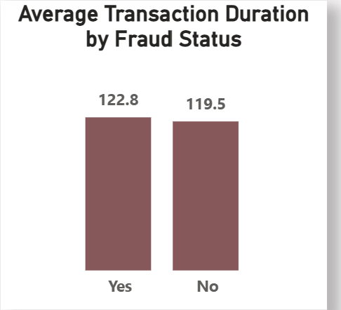
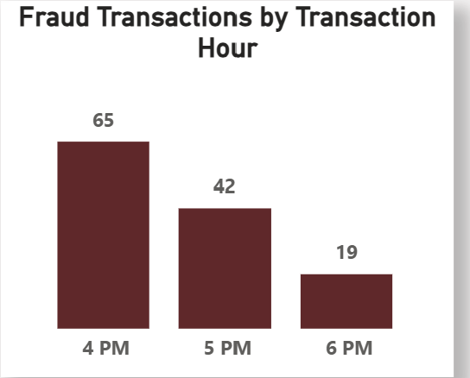
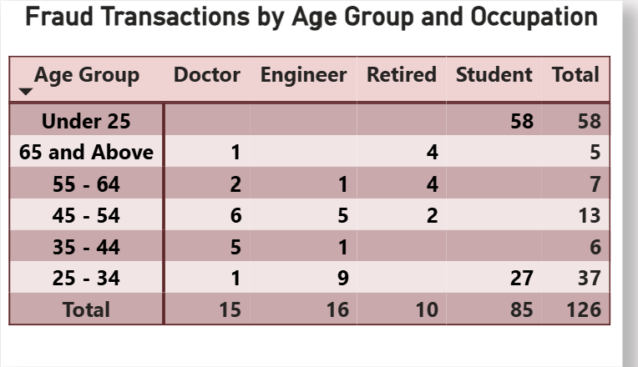
Average transaction duration of Fraud transaction is 122.8 which is slightly higher than the average transaction duration of non-fraud transactions (119.5).
Fraud transaction is highest at 4pm with 65 transactions and steadily declined through 5pm (42 transactions) and 6pm(19 transactions).
Fraud transactions are highest among individuals “under 25” years with 58 cases followed by individuals between “25 – 34” years.
Students are heavily impacted with 85 transactions followed by Engineers (16 transactions) and Doctors (15 transactions).

Slide 10
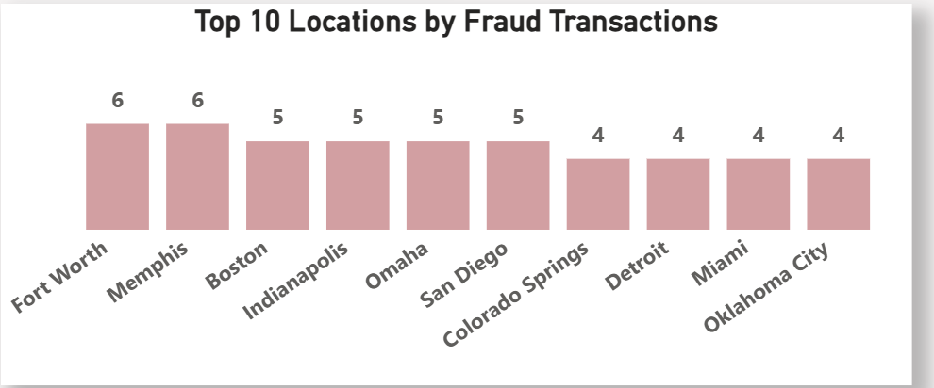
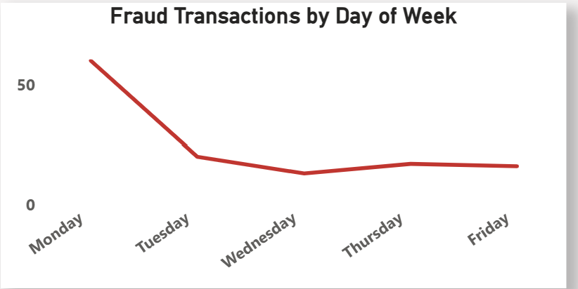
Fort Worth and Memphis recorded the highest number of fraud transactions (6 transactions each), followed by Boston, Indianapolis, Omaha and San Diego (5 transactions each.
Fraud losses were highest on Monday with 60 transactions and declined over the remainder of the working week.

Slide 11
Recommendations
Strengthen online banking security using multi-factor authentication, biometric verification and one – time passwords.
Monitor and verify high-value transactions in real time.
Apply enhanced fraud detection rules and transaction monitoring to debit transactions and credit transactions.
Educate customers, especially younger users, about fraud prevention. Provide regular fraud awareness campaigns on phishing, password security, missing ATM cards and safe online banking practices. Strengthen in-branch verification and provide regular staff training to prevent fraudulent transactions.
Implement real-time fraud monitoring and risk-based authentication for unusual logins, devices, and locations.
Continuously monitor high-risk locations and transaction patterns.

Slide 12
Conclusion
The analysis found that 5.02% of transactions were fraudulent, resulting in approximately 79,791 in fraud losses. Although fraudulent transactions occurred less frequently than legitimate transactions, fraudulent transactions had a much higher average value (633).
Online banking, debit transactions, younger customers, and certain transaction times and locations showed increased risk. Therefore, the bank should strengthen authentication, monitor high-value and unusual transactions in real time, improve branch verification procedures, and educate customers about fraud prevention.

Slide 13
Questions and Discussion
Thank you for your attention.
I welcome your questions or feedback

